Slide 1
Using Measures of Community Collaboration to Strengthen Public Health Interventions
The Center for Public Health Evaluation and Research &
Consortium for Substance Abuse Research and Evaluation

Slide 2
Project analysis slide 3
Speakers
Brad Richardson, Ph.D. Sherry Gao, Ph.D.
University of Iowa, Center for Public Health Evaluation and Research &
Consortium for Substance Abuse Research and Evaluation
Notes:
Include Disclosure

Slide 3
Standard Surveys Compared to Network Data
Gather information on perceptions about community collaboration
General attitudes, values, beliefs, ratings, opinions
Social network data are information about relationships
Who, What, When, How – specific to relationship, not general
Notes:
The standard survey approach seeks information on perceptions about community collaboration among representatives of local agencies that may serve those who are homeless and have co-occurring disorders.
The social network analysis uses information about relational patterns among agencies as indicated by the same representatives who completed the survey.

Slide 4
Relational Data from Agencies
Standard surveys gather information about general perceptions
Social network analysis uses information specific to relationships
The combination of the two methods provides a powerful tool for improving strengths in community collaboration needed for effective public health interventions.
What people say v. what people do
Notes:
While surveys gather information about general perceptions of collaboration, social network analysis provides specific information about relationships.
The combination of the two methods provides a powerful tool for improving strengths in community collaboration needed for effective public health interventions.
Also allows us to compare what those in a community believe and say about the general state of collaboration, to what they actually do in relation to and with others in the community.

Slide 5
STRENGTHENING COMMUNITIES - YOUTH (SCY) Social Network Analysis of Collaboration among Service Network Providers
The purpose of the network analysis is to measure change in the network of provider agencies. In so doing, we assess the level of achievement of two of the six SCY goals:
Develop linkages and networking mechanisms to facilitate identification assessment, referral, and treatment of youth with substance abuse problems and their families.
Develop and implement outreach activities to educate the community with the goal of leading to early identification; also demonstrate familiarity with state-of-the-art science and practices in area of identification, referral, and treatment.

Slide 6
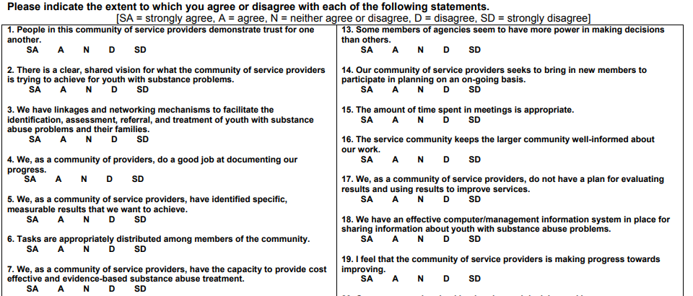
Strengthening Communities - Youth Service Network Survey

Slide 7
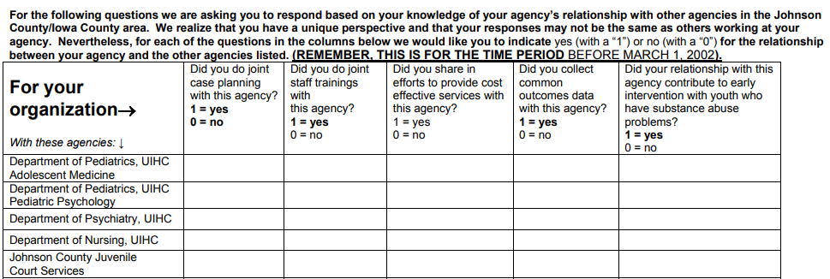
Strengthening Communities - Youth Service Network Survey
Agency 1
Agency 2
Agency 3
Agency 4
Agency 5

Slide 8
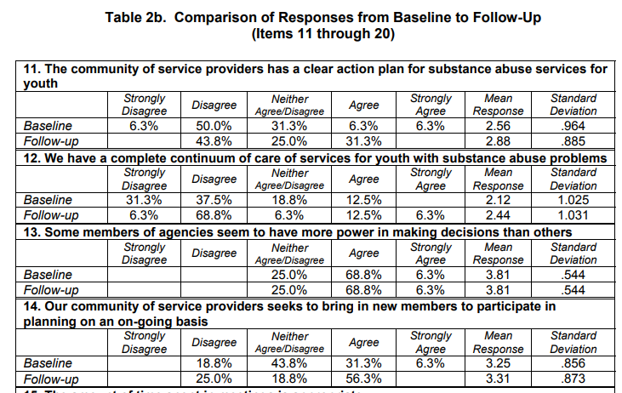
STRENGTHENING COMMUNITIES - YOUTH (SCY) Social Network Analysis of Collaboration among Service Network Providers

Slide 9
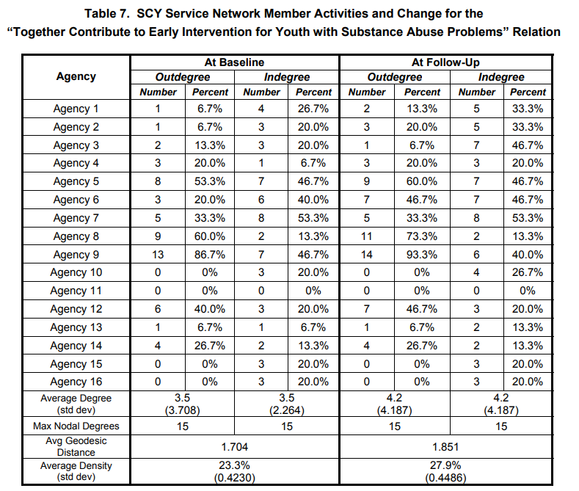
STRENGTHENING COMMUNITIES - YOUTH (SCY) Social Network Analysis of Collaboration among Service Network Providers

Slide 10
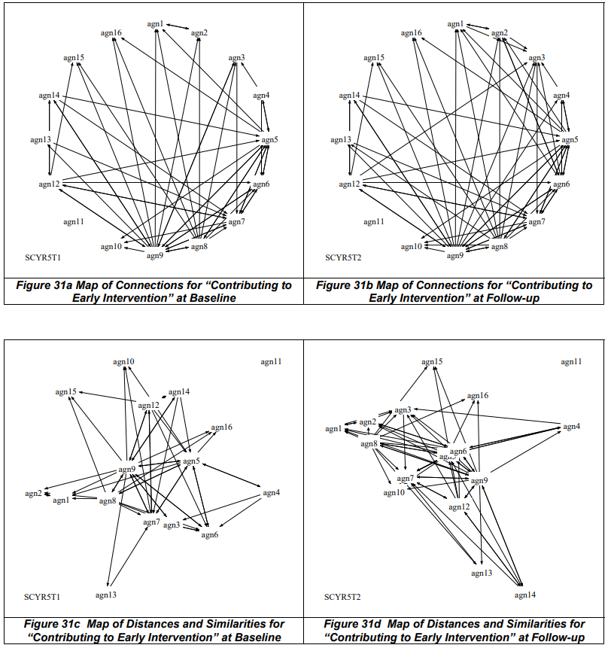
STRENGTHENING COMMUNITIES - YOUTH (SCY) Social Network Analysis of Collaboration among Service Network Providers

Slide 11
Assessment of Community Collaboration in one Iowa County

Slide 12
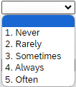
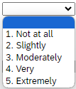
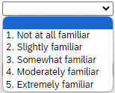
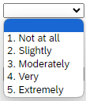
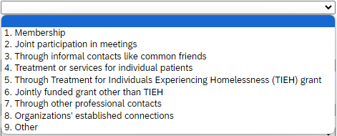
Assessment of Community Collaboration - Survey
Questions | Strongly agree | Agree | Neutral | Disagree | Strongly disagree
1. Staff of providers in our community demonstrate trust for one another.
2. There is a clear, shared vision for what our community is trying to do to serve individuals and families in need.
3. In our community, service providers do a good job at documenting our progress and measuring outcomes.
 | How frequently did you interact with the agency in the past 3 months? | How much do you like to work with this agency? | Are you familiar with the services this agency provides? | How effective are you in working together with this agency for people with co-occurring disorders and experiencing homelessness? | How did you first establish the connection with this agency?
Agency 01
Agency 02
Agency 03

Slide 13
Assessment of Community Collaboration - Survey
Statement with higher agreement scores | Mean Score
Staff of providers in our community demonstrate trust for one another | 4.00
I have an equal voice within this service provider community | 3.90
There is a clear, shared vision for what our community is trying to do to serve individuals and families in need | 3.80
In our community, service providers do a good job at documenting our progress and measuring outcomes | 3.70
In our community, service providers effectively communicate with each other | 3.70
The service providers in our community usually identify specific, measurable results that we want to achieve | 3.60
Service providers in this community commonly share information and resources to assist those experiencing co-occurring disorders and homelessness | 3.60
Notes:
Trust, equal, shared vision, communication,

Slide 14
Assessment of Community Collaboration - Survey
Statement with lower agreement scores | Mean Score
Every provider agency seems to have equal power in making decisions | 3.10
Consumers are involved in planning and decision-making | 3.10
Our service provider community adequately meets the cultural and language needs of minority groups | 3.10
In our area, we have frequent communication and collaborate with programs serving people with co-occurring disorders who are also experiencing homelessness | 3.00
People in our community agree on which issues are most important for people with co-occurring disorders who are also experiencing homelessness | 3.00
We plan for sustaining initiatives after initial grant funds run out | 2.90
I feel our community is making progress toward improving services for people with co-occurring disorders and experiencing homelessness | 2.90
Notes:
Outcome, racial, sustaining, making decisions

Slide 15
Social Network Relations Survey
The social network analysis is based on responses to four relational questions:
How frequently did you interact with the agency in the past 3 months?
How much do you like to work with this agency?
Are you familiar with the services this agency provides?
How effective are you in working together with this agency for people with co-occurring disorders and experiencing homelessness?

Slide 16
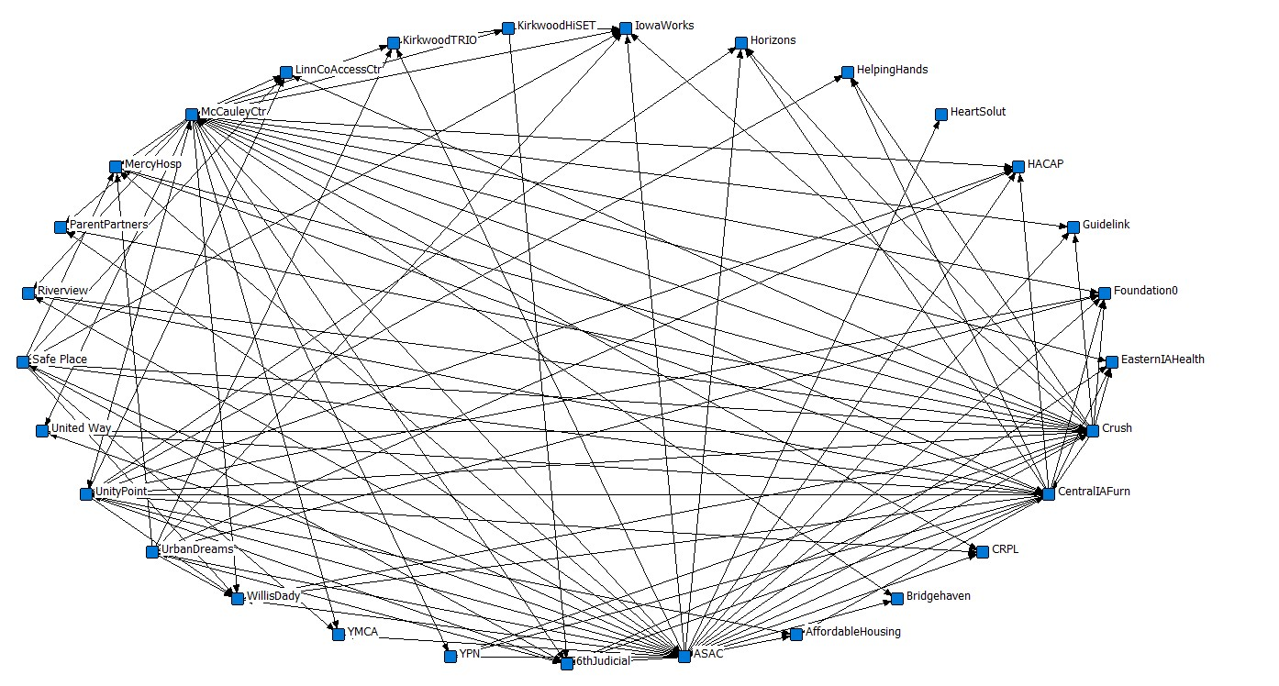
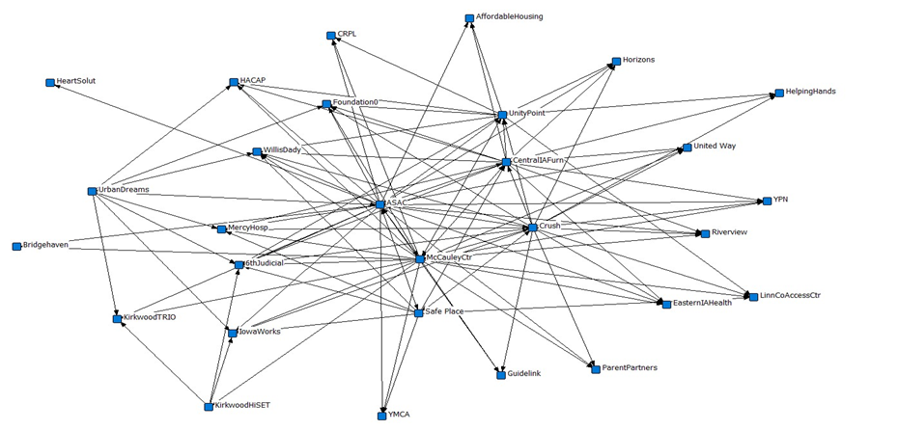
Social Network Relations: “How frequently did you interact with the agency in the past 3 months?”

Slide 17
Social network findings
Indegree and outdegree
Density, centralization, and reachability
Betweenness or betweenness centrality
Geodesic distance
Notes:
Define, why they matter, present one example of the measures,

Slide 18
Network measures and terminology
Agency | Outdegree |  | Indegree
 | Number | Percent | Number | Percent
Agency 1 | 0 | 0% | 3 | 11%
Agency 2 | 0 | 0% | 5 | 18%
Agency 3 | 0 | 0% | 3 | 11%
Agency 4 | 25 | 89% | 5 | 18%
Agency 5 | 15 | 54% | 4 | 14%
Agency 6 | 0 | 0% | 4 | 14%
Agency 7 | 22 | 79% | 4 | 14%
Agency 8 | 9 | 32% | 2 | 7%
Agency 9 | 0 | 0% | 4 | 14%
Agency 10 | 0 | 0% | 4 | 14%
Agency 11 | 0 | 0% | 7 | 25%
Agency 12 | 0 | 0% | 4 | 14%
Agency 13 | 8 | 29% | 1 | 4%
Agency 14 | 10 | 36% | 4 | 14%
Average degree (SD) | 4.08 (7.25) |  | 3.83 (1.66)
Max Nodal Degrees | 30
Avg. Geodesic distance | 1.289474
Network centralization | 78% |  | 15%

Slide 19
Network measures and terminology
Agency | Outdegree |  | Indegree
 | Number | Percent | Number | Percent
Agency 1 | 0 | 0% | 3 | 11%
Agency 2 | 0 | 0% | 5 | 18%
Agency 3 | 0 | 0% | 3 | 11%
Agency 4 | 25 | 89% | 5 | 18%
Agency 5 | 15 | 54% | 4 | 14%
Agency 6 | 0 | 0% | 4 | 14%
Agency 7 | 22 | 79% | 4 | 14%
Agency 8 | 9 | 32% | 2 | 7%
Agency 9 | 0 | 0% | 4 | 14%
Agency 10 | 0 | 0% | 4 | 14%
Agency 11 | 0 | 0% | 7 | 25%
Agency 12 | 0 | 0% | 4 | 14%
Agency 13 | 8 | 29% | 1 | 4%
Agency 14 | 10 | 36% | 4 | 14%
Average degree (SD) | 4.08 (7.25) |  | 3.83 (1.66)
Max Nodal Degrees | 30
Avg. Geodesic distance | 1.289474
Network centralization | 78% |  | 15%
Indegree: how many connections or choices one receives from others;
Outdegree: how many connections one has to others.
Notes:
If an agency collaborates equally with all other agencies, there is no variability, degree=0. If one agency collaborates with all other agencies, and all other agencies do not collaborate except with this one agency, then degree=1 (this results in a network diagram in the shape of a star with one agency in the middle and lines radiating out.

Slide 20
Network measures and terminology
Agency | Outdegree |  | Indegree
 | Number | Percent | Number | Percent
Agency 1 | 0 | 0% | 3 | 11%
Agency 2 | 0 | 0% | 5 | 18%
Agency 3 | 0 | 0% | 3 | 11%
Agency 4 | 25 | 89% | 5 | 18%
Agency 5 | 15 | 54% | 4 | 14%
Agency 6 | 0 | 0% | 4 | 14%
Agency 7 | 22 | 79% | 4 | 14%
Agency 8 | 9 | 32% | 2 | 7%
Agency 9 | 0 | 0% | 4 | 14%
Agency 10 | 0 | 0% | 4 | 14%
Agency 11 | 0 | 0% | 7 | 25%
Agency 12 | 0 | 0% | 4 | 14%
Agency 13 | 8 | 29% | 1 | 4%
Agency 14 | 10 | 36% | 4 | 14%
Average degree (SD) | 4.08 (7.25) |  | 3.83 (1.66)
Max Nodal Degrees | 30
Avg. Geodesic distance | 1.289474
Network centralization | 78% |  | 15%
Degree: Quantifies the range or variability of agency connectedness (based on graph centralization theory)
Nodal degrees: number of lines connected to a node

Slide 21
Network measures and terminology
Agency | Outdegree |  | Indegree
 | Number | Percent | Number | Percent
Agency 1 | 0 | 0% | 3 | 11%
Agency 2 | 0 | 0% | 5 | 18%
Agency 3 | 0 | 0% | 3 | 11%
Agency 4 | 25 | 89% | 5 | 18%
Agency 5 | 15 | 54% | 4 | 14%
Agency 6 | 0 | 0% | 4 | 14%
Agency 7 | 22 | 79% | 4 | 14%
Agency 8 | 9 | 32% | 2 | 7%
Agency 9 | 0 | 0% | 4 | 14%
Agency 10 | 0 | 0% | 4 | 14%
Agency 11 | 0 | 0% | 7 | 25%
Agency 12 | 0 | 0% | 4 | 14%
Agency 13 | 8 | 29% | 1 | 4%
Agency 14 | 10 | 36% | 4 | 14%
Average degree (SD) | 4.08 (7.25) |  | 3.83 (1.66)
Max Nodal Degrees | 30
Avg. Geodesic distance | 1.289474
Network centralization | 78% |  | 15%
Geodesic distance: the shortest distance or path between nodes.
Centralization: the extent one or a few more relationally active members, form the center of the network or network activity, and may reveal if there are multiple centers, or if there are isolates not connected to other members.

Slide 22
Recommendations
1
When measuring interagency collaboration, it is important to examine organizational levels within the network because collaboration may occur differently within and between these organizational levels
2
To obtain more accurate information, reaching out to programs that did not respond to explain the purpose of gathering this information could result in a better response rate.
3
To be most effective, measures of interagency collaboration should take place at multiple points in time over the life of the collaborative effort. Measures taken at baseline and near the end of an initiative are important for demonstrating change in interagency collaboration to funders.
Notes:
Replace the footer, add consortium info

Slide 23
Improvement in network - Reassessment
Using network information in the context of improving collaboration is about making meaning from information to figure out what is working well, what problems there are, and formulating action plans.
Some facilitating questions:
How does the network appear compared to how you imagined it would look?
Suppose something happened and collaboration in the community is exactly as you want it to be, what would be the first difference you would notice?
In what ways has collaboration been effective, and what do you plan to do next?
Notes:
Progress starts with, “I want…” (or more likely at the outset, “I don’t want…”). “I want” reveals a problem that is ready to be addressed now. Whatever the stated desire, problem, etc. is, that is the place to start even if it does not coincide with the results being discussed.
Some facilitating questions:
How does the network appear compared to how you imagined it would look?
Suppose something happened and collaboration in the community is exactly as you want it to be,
what would be the first difference you would notice? … Then what?… What else?…
In what ways has collaboration been effective, and what do you plan to do next?

Slide 24
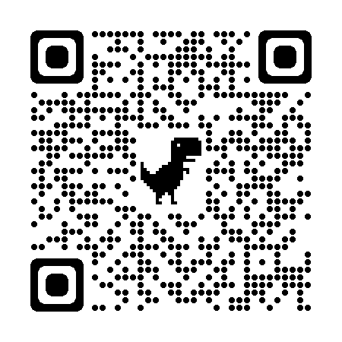
Questions?
Xueying (Sherry) Gao, Ph.D.
Assistant Research Scientist/Engineer
National Resource Center for Family Centered Practice
University of Iowa School of Social Work
xueying-gao@uiowa.edu
Brad Richardson, Ph.D.
Research Director, Adjunct Associate Professor
National Resource Center for Family Centered Practice
University of Iowa School of Social Work
brad-richardson@uiowa.edu
uiowa.edu
https://nrcfcp.uiowa.edu/

Slide 25
Thank you
Xueying (Sherry) Gao, Ph.D.
Assistant Research Scientist/Engineer
National Resource Center for Family Centered Practice
University of Iowa School of Social Work
xueying-gao@uiowa.edu
Brad Richardson, Ph.D.
Research Director, Adjunct Associate Professor
National Resource Center for Family Centered Practice
University of Iowa School of Social Work
brad-richardson@uiowa.edu
https://nrcfcp.uiowa.edu/

