Slide 1
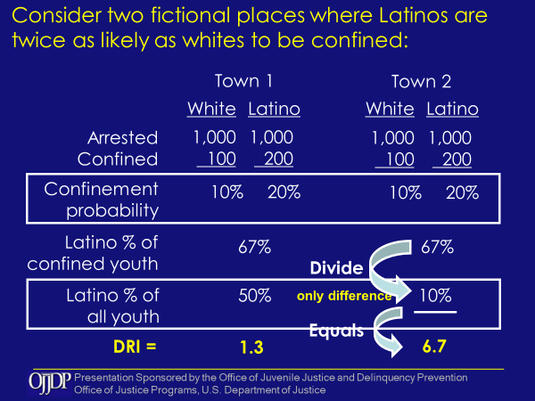
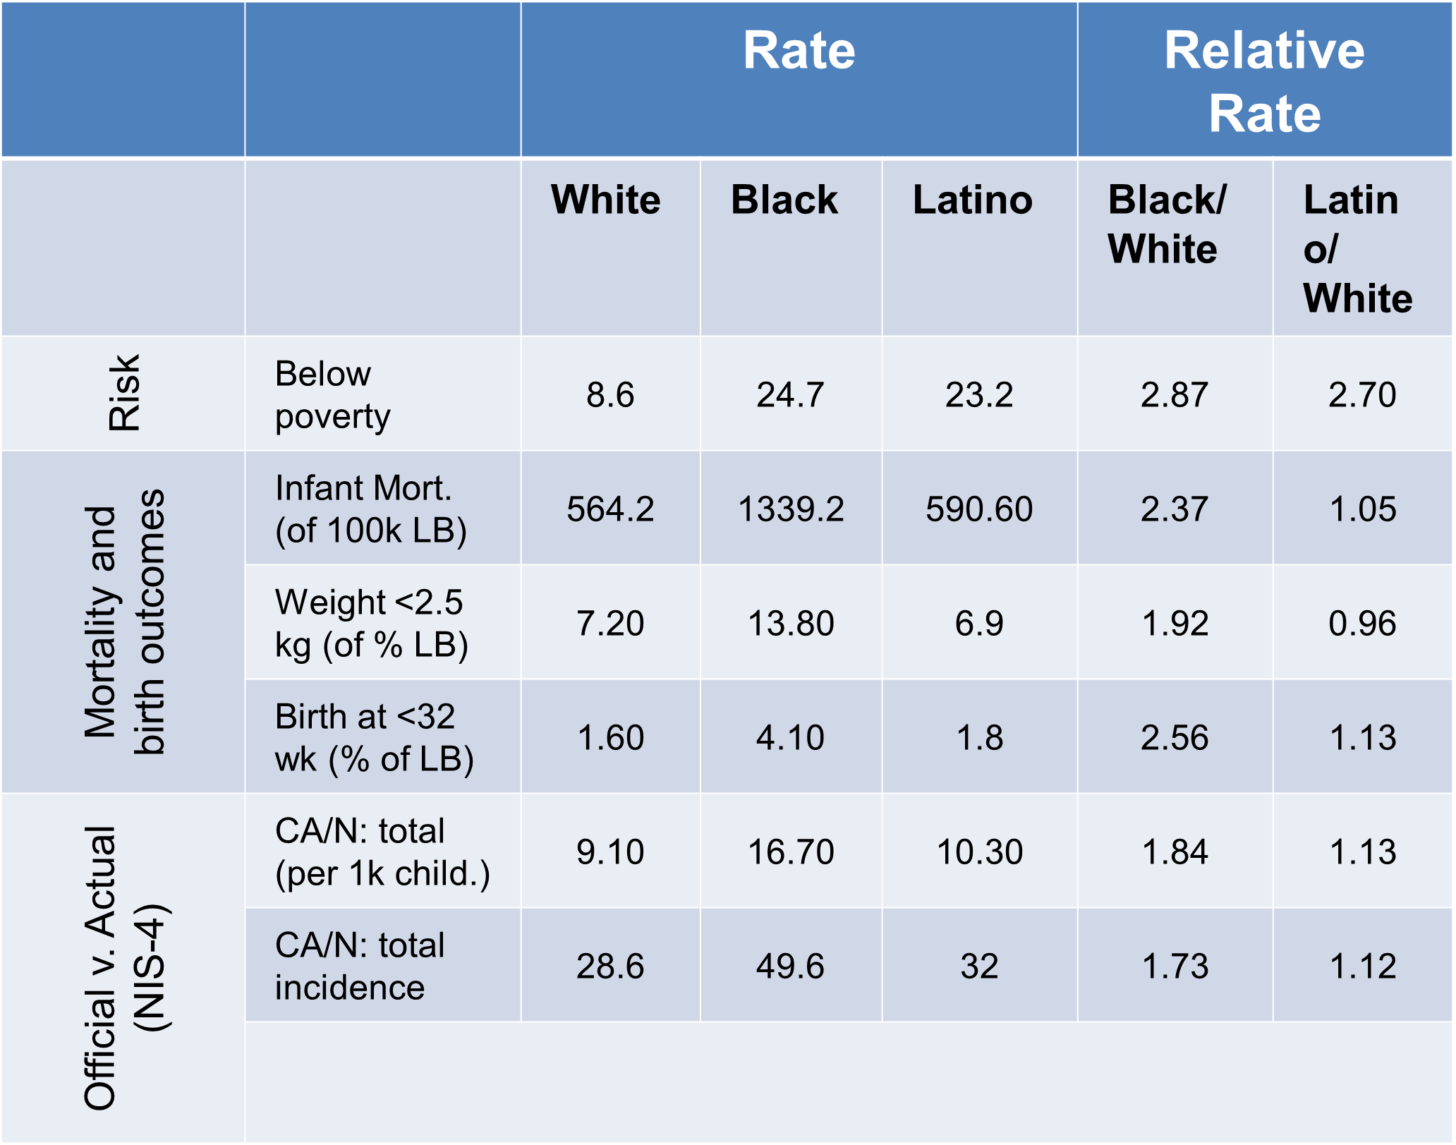
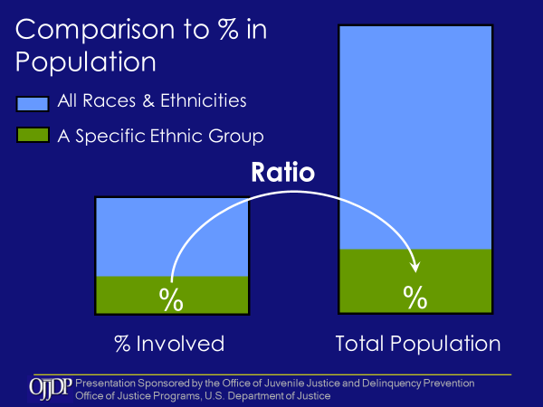
Improving Health Equity Through More Accurate Assessments of Disparities:
An Unbiased Estimator for Calculating Racial Disparities
Xueying Gao, Ph.D. Brad Richardson, Ph.D.
University of Iowa Center for Public Health Evaluation and Research & Consortium for Substance Abuse Research and Evaluation | School of Social Work, NRC for Family Centered Practice
Introduction
Old Method
New Method
Discussions
Measuring disparities alerts us to potential problems and where to focus efforts when it is determined there is a problem. Mapping decision points and using disparity rates can identify which decision points in a system are contributing to disparities.
Disproportionality has most frequently been calculated based on comparing percentages experiencing a condition (e.g., incarceration) to the percentage corresponding groups (e.g., race) make up in the population. Using rates (e.g., rate per 100 by group) instead of percentages, and using rates in a sequence of decision points in a system, obtains an unbiased measure.
Why is the disproportionality rate using the percent in the population a biased estimator? It relies on the makeup of the local population. For example, at the state level, a state with a high non-white population will have a lower maximum disproportionality rate than a state with a lower non-white population where white is used as the comparison. A state with 50% non-white population could only show over-representation up to 2x the number in the general population, whereas a state with a 10% non-white population would have a maximum of 10x over-representation. As a result, the ratio calculation is not comparable across groups, not comparable with other locations with a different population makeup, and accurate as a measure to identify where in a system disparity is evidenced because of the bias in the measure.
Here is a practical example of two towns with identical characteristics except for the percent of Latino youth. Everything is the same as you move through the calculations until Latino % of all youth enters the equation. Suddenly Town 2 has a disproportionality rate of 6.7 compared to Town 1 with 1.3. Why is this? Because the disproportionality rate index using percent of population is affected by the percent in the population regardless of any other factor.
What does this mean? It means the method of using the percent of the population for comparison is biased and different results are obtained depending on the makeup of the population. When looking at decision points in a system, comparing to group percentages in the population creates further issues because population percentages may not be the same as the number “at risk” at subsequent decision points. Comparisons with other locations, and comparisons at decision points are not accurately measured using comparison to population percentages.
The alternative method using relative rates addresses the statistical bias found when comparing to the percent of the population. This method uses the actual number of those affected, and their number in the population; to calculate the observed rate. This method is more accurate for comparing differences between different locations. It is also more accurate for comparing among groups, and through a set of decision points in a system. This is because the denominator at any decision point reflects the number at risk based on those remaining from the previous decision point. The method takes into account the number remaining at risk for the next decision point in a system. As a result, this is a much more accurate estimate than comparing to the percent of the population.
The method presented offers important considerations regarding measurement for practical use. Findings from comparisons of relative rates and disproportionality rates show the validity of the use of relative rates and improvement in accuracy comparing between groups and between decision points. An example of results across related events, e.g., decision points in a system, is presented in the table below. The data only identify where disparities exist. Assessment to diagnose potential reasons why differences exist must be performed. Interventions based on assessment can then be put in place, evaluated, and monitored using ongoing updates of the relative rate calculations to assess effectiveness of those interventions. This public health approach is particularly helpful for application to other systems such as early child health, child welfare, justice, crime, and educational systems where disparities have been notable for many years.
What does this mean?
Disproportionality is a biased estimator.
Use relative rates per 100 or 1000:
More accurately examines group differences
More accurately measures rates at decision points
https://icsa.uiowa.edu/ https://pubhealtheval.org.uiowa.edu

